Slide 1

AI-Driven Academic Risk & Dropout Early-Warning System
Mini Project – Review 2
Presented by
Altrin Benser A - 962223205010 John Jins J - 962223205032
Jerish Rethna J - 962223205029 Mukhilan S - 962223205040
Guide:
Er. Agnes Alex Rathy P
Assistant Professor/IT

Slide 2
Abstract, Problem Statement & Objectives
Abstract
Traditional systems find weak students only after exam results and keep data as static records.
Digital Class Twin captures attendance, assessment, quiz and behavior data as events and keeps a live digital twin of each student.
Risk is scored with explainable factors and shown on role-based dashboards for teachers, counselors and parents.
Problem Statement
Weak students are identified only after examination or semester results.
Static records do not show how performance changes over time.
Attendance-threshold rules miss the complete academic situation.
No mechanism for continuous monitoring and early intervention.
Objectives
Continuously collect attendance, assessment and behavior data
Maintain a Digital Twin per student: current state, history, sync status
Predict academic risk: Low, Medium, High
Predict future GPA using machine learning (planned)
Analyze trajectory: Declining, Stable, Recovering
Give explainable factors behind every prediction
Provide what-if simulation for interventions
Support early intervention by recording actions and outcomes

Slide 3
Literature Survey , Summary and Research Gap
20 papers reviewed (2021–2025): dropout prediction, early warning, educational data mining, explainable AI – listed in References
Research Gap
Major Methods
  Many studies use static or institution-specific datasets.
  Most focus mainly on prediction rather than continuous monitoring.
  Limited integration of academic, attendance and behavioural events.
  Few systems connect predictions directly with interventions.
  Machine Learning: Random Forest, Decision Tree, SVM, Logistic Regression
  Ensemble & Boosting methods for dropout prediction
  Educational Data Mining and Learning Analytics
  SHAP / Explainable AI for prediction interpretation
  Digital Twin & graph-based student pathway modelling
Key Findings
Relevance to Our Project
  ML can predict academic performance and dropout risk at an early stage.
  Attendance, academic performance, LMS activity and behaviour are important indicators.
  Combining multiple student data sources improves risk prediction.
  XAI helps identify the factors influencing predictions.
  Our Digital Class Twin extends existing ML and Digital Twin approaches.
  Uses event-driven continuous monitoring and time-series student state.
  Provides Low/Medium/High risk, GPA prediction and trajectory-based urgency.
  Uses SHAP, What-If simulation and intervention logging for actionable decisions.

Slide 4
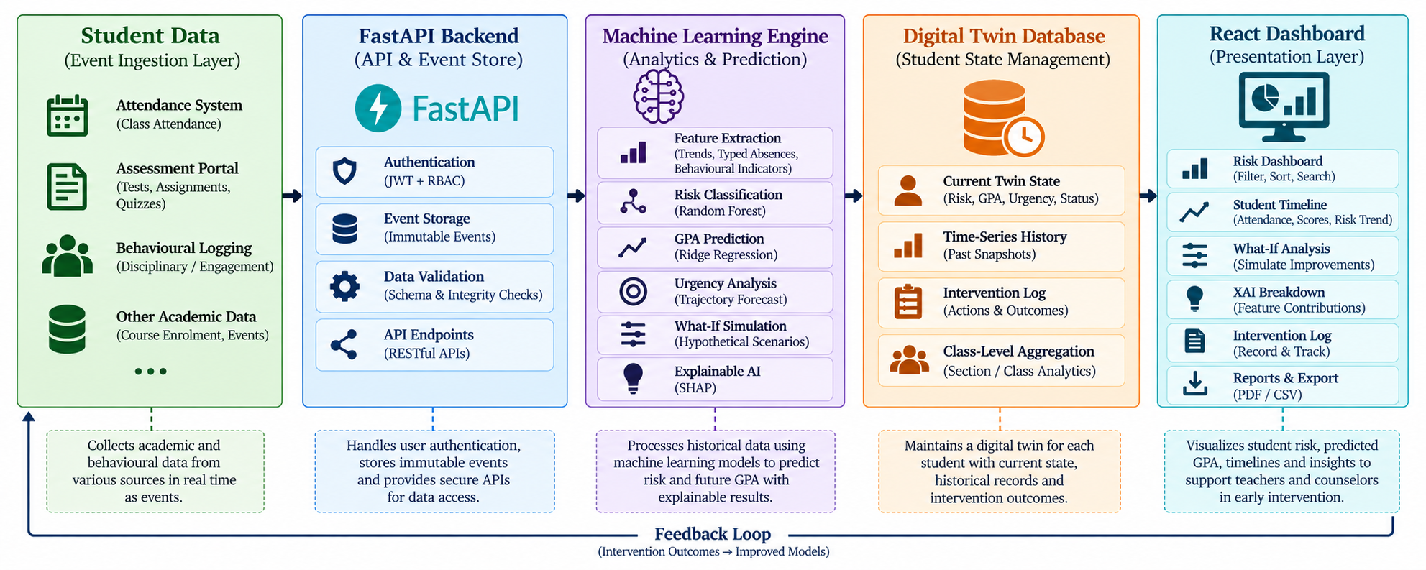


Proposed System Architecture
Events → FastAPI ingestion → Rules & features → Risk engine → Twin & alerts → Database → REST API (JWT) → React dashboards

Slide 5
Design Methodology (Model, Algorithm, DB Design)
Algorithm
Model
DB Design
Receive typed event (attendance, marks, behavior)
Composite risk score
score = 0.5 × Academic + 0.3 × Attendance + 0.2 × Behavior
Users & access
User, UserSession, ParentChildMap, TeacherClassMap
Events & features
Event, StudentFeatures
Risk & twin
RiskScore, DigitalTwin, TwinSnapshot, Alert, InsightReview
SQLAlchemy ORM · SQLite (dev) · Alembic migrations
1
▼
Normalize, validate and store event
2
▼
Recompute features: attendance %, marks trend, behavior
3
≥ 75 Low → stable
▼
Compute composite risk score
4
50 – 74 Moderate → warning
▼
Set twin state; save snapshot if state or risk changed
< 50 High → critical
5
▼
Rule/threshold-based, explainable model (risk_engine.py). Trained ML model is the next step.
Raise alert on risk change, with explanation
6

Slide 6
Implementation Details (Framework, Design)
Framework / Technology Stack
Project modules
backend/ – FastAPI APIs, auth, event pipeline, DB models
client-app/ – React + Vite role-based dashboards
ml-engine/ – features, risk, forecasting, twin updater
shared-contracts/ – event and twin JSON schemas
Role-based dashboards
Student: Dashboard, Digital Twin, Insights, Alerts, Submit Event, Rewards, Profile
Teacher: Dashboard, Class Overview, Risk Hub
Parent: Dashboard, Child Twin, Academic Reports
Admin: Dashboard, Audit Log, System Health
REST API routers
auth, events, twins, insights, alerts, dashboard, profile, sessions, admin
Layer | Technologies
Frontend | React, Vite, Axios, React Router, custom CSS
Backend | Python, FastAPI, Uvicorn, Pydantic
Database | SQLAlchemy ORM (SQLite dev), Alembic migrations
Security | JWT authentication, password hashing, role-based access
ML engine | Python; rule-based scoring (risk_engine.py, forecasting_engine.py)
Tools | Git/GitHub, Swagger (/docs), Postman

Slide 7
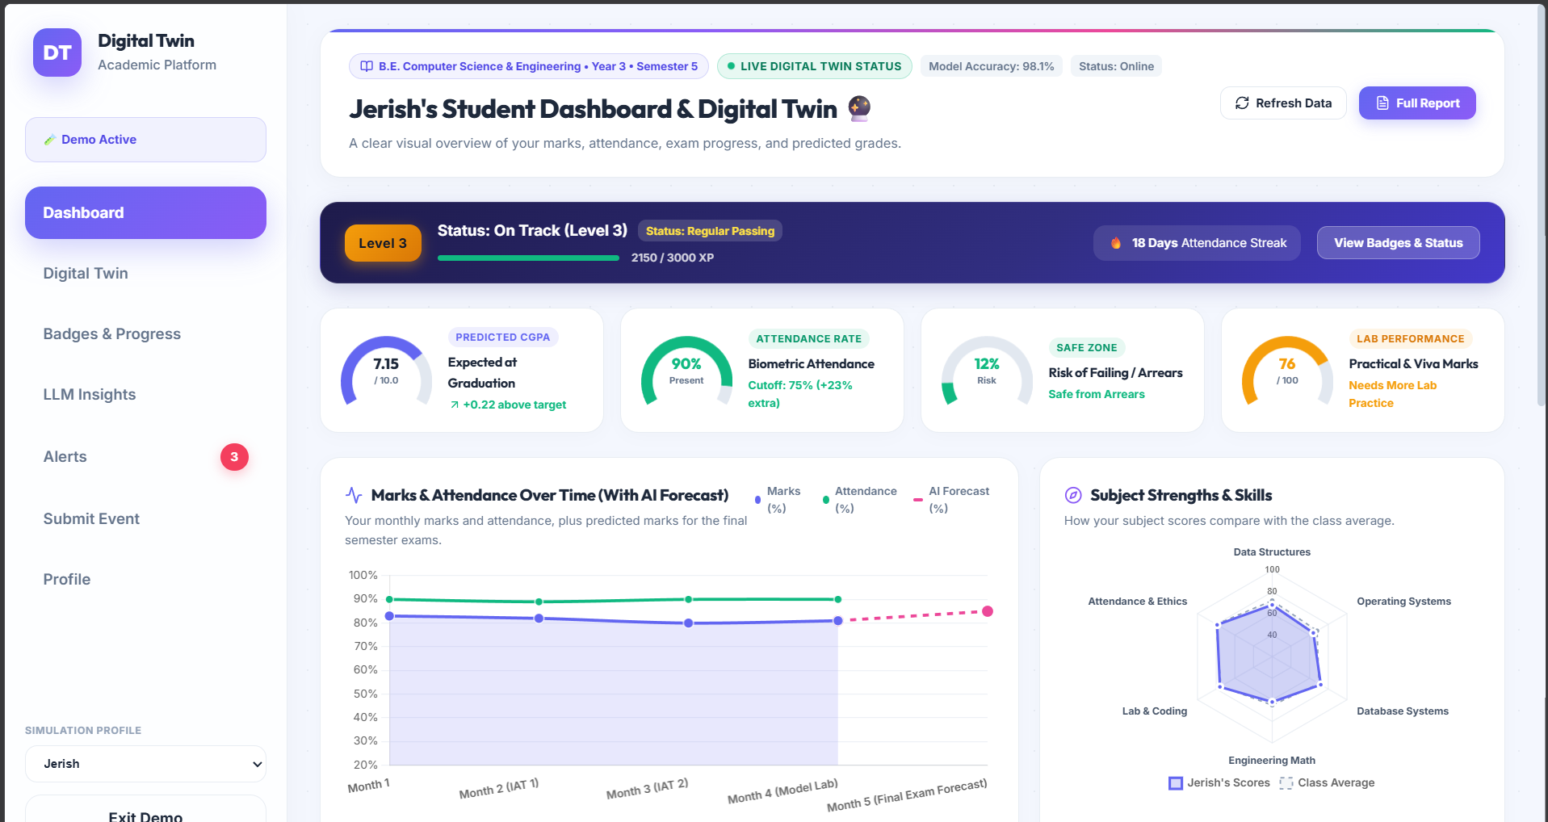
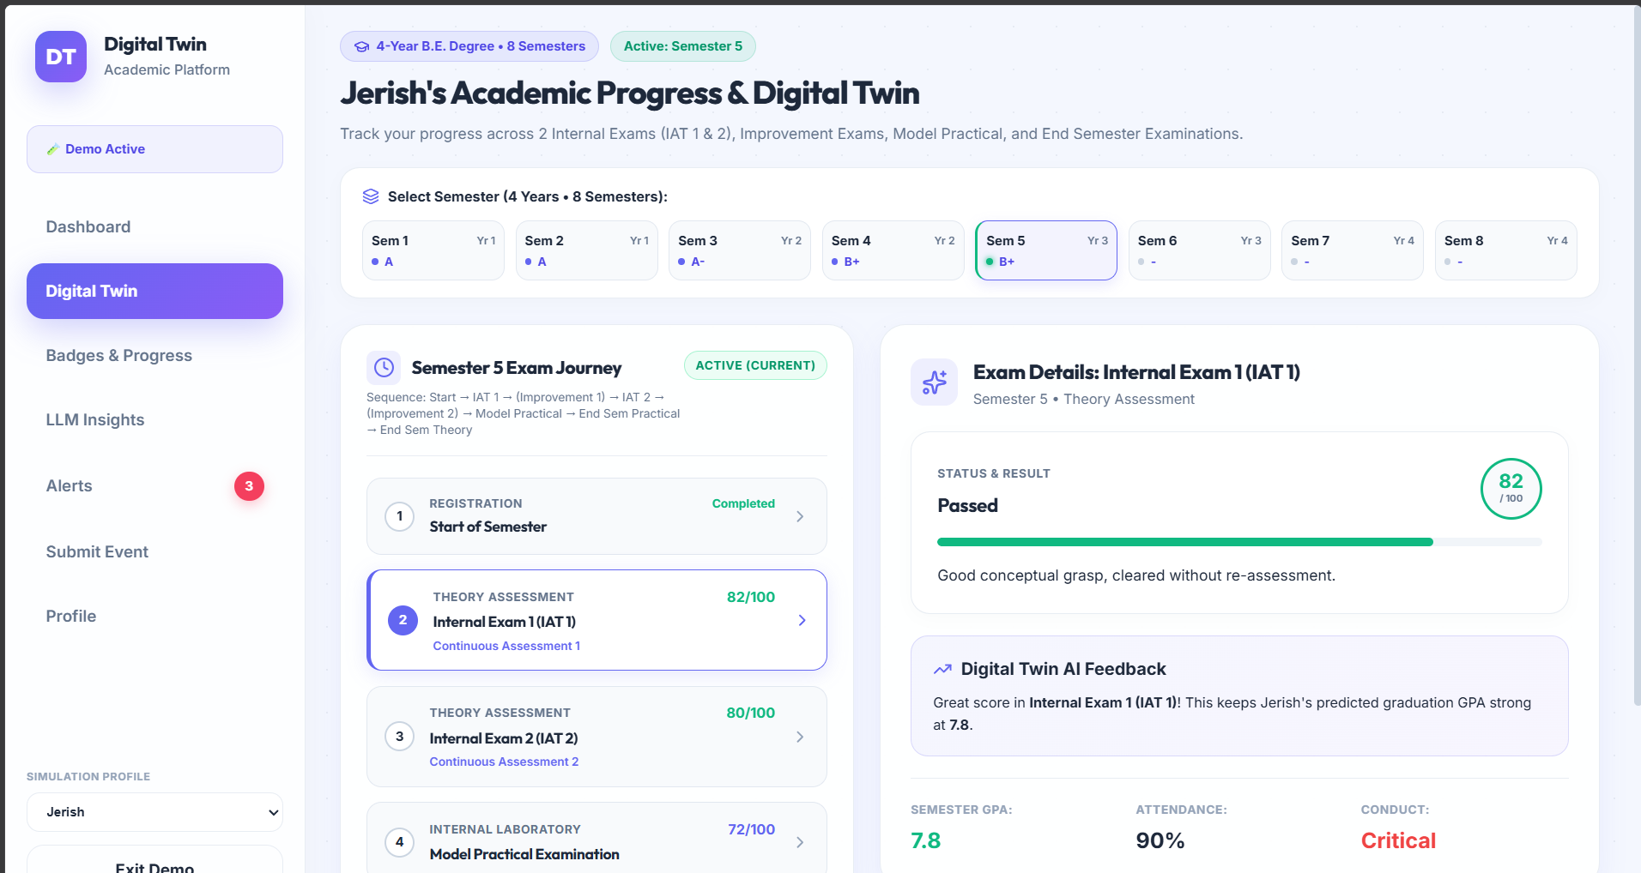
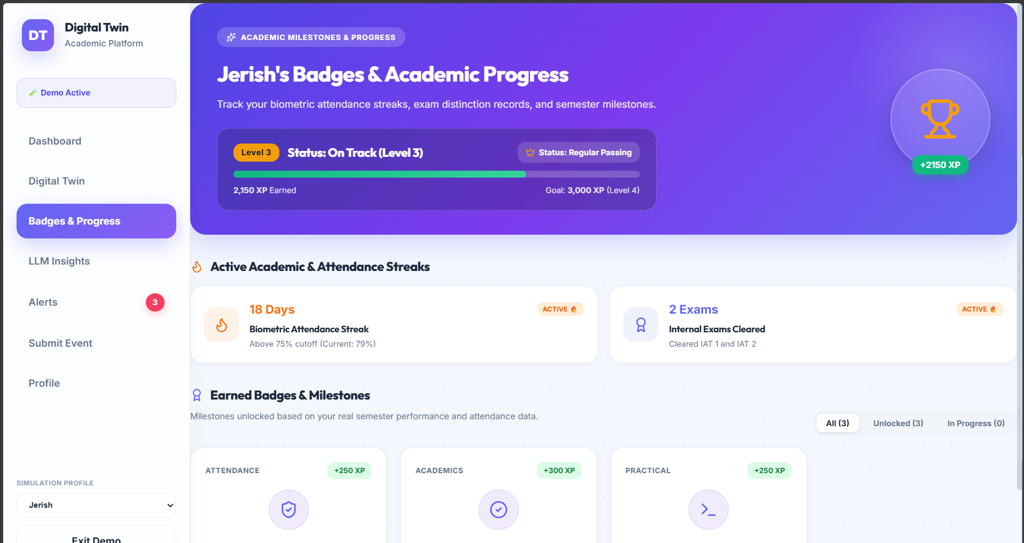
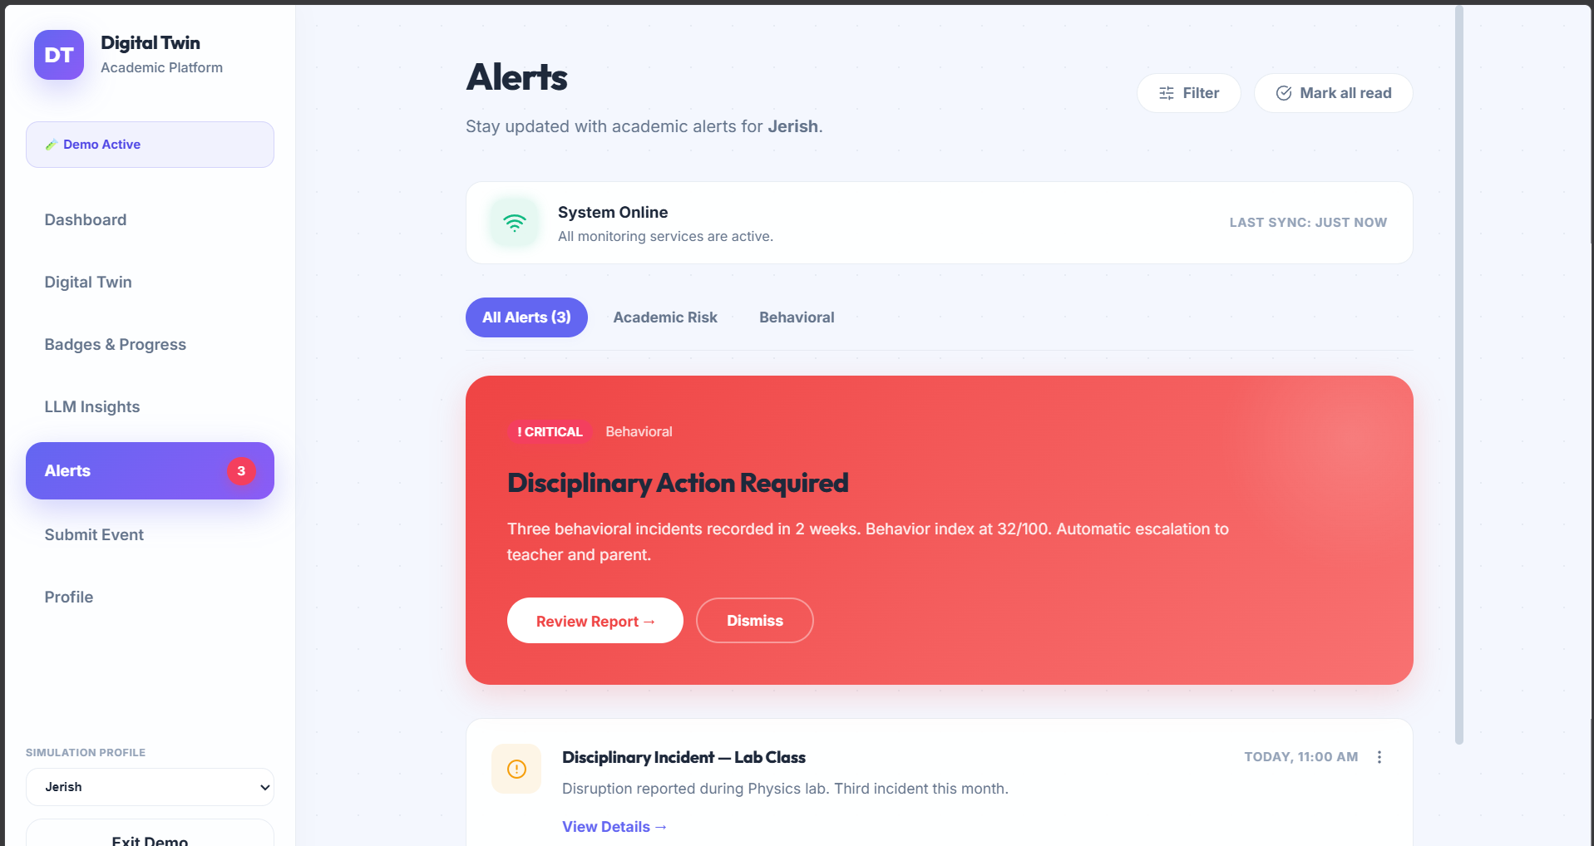
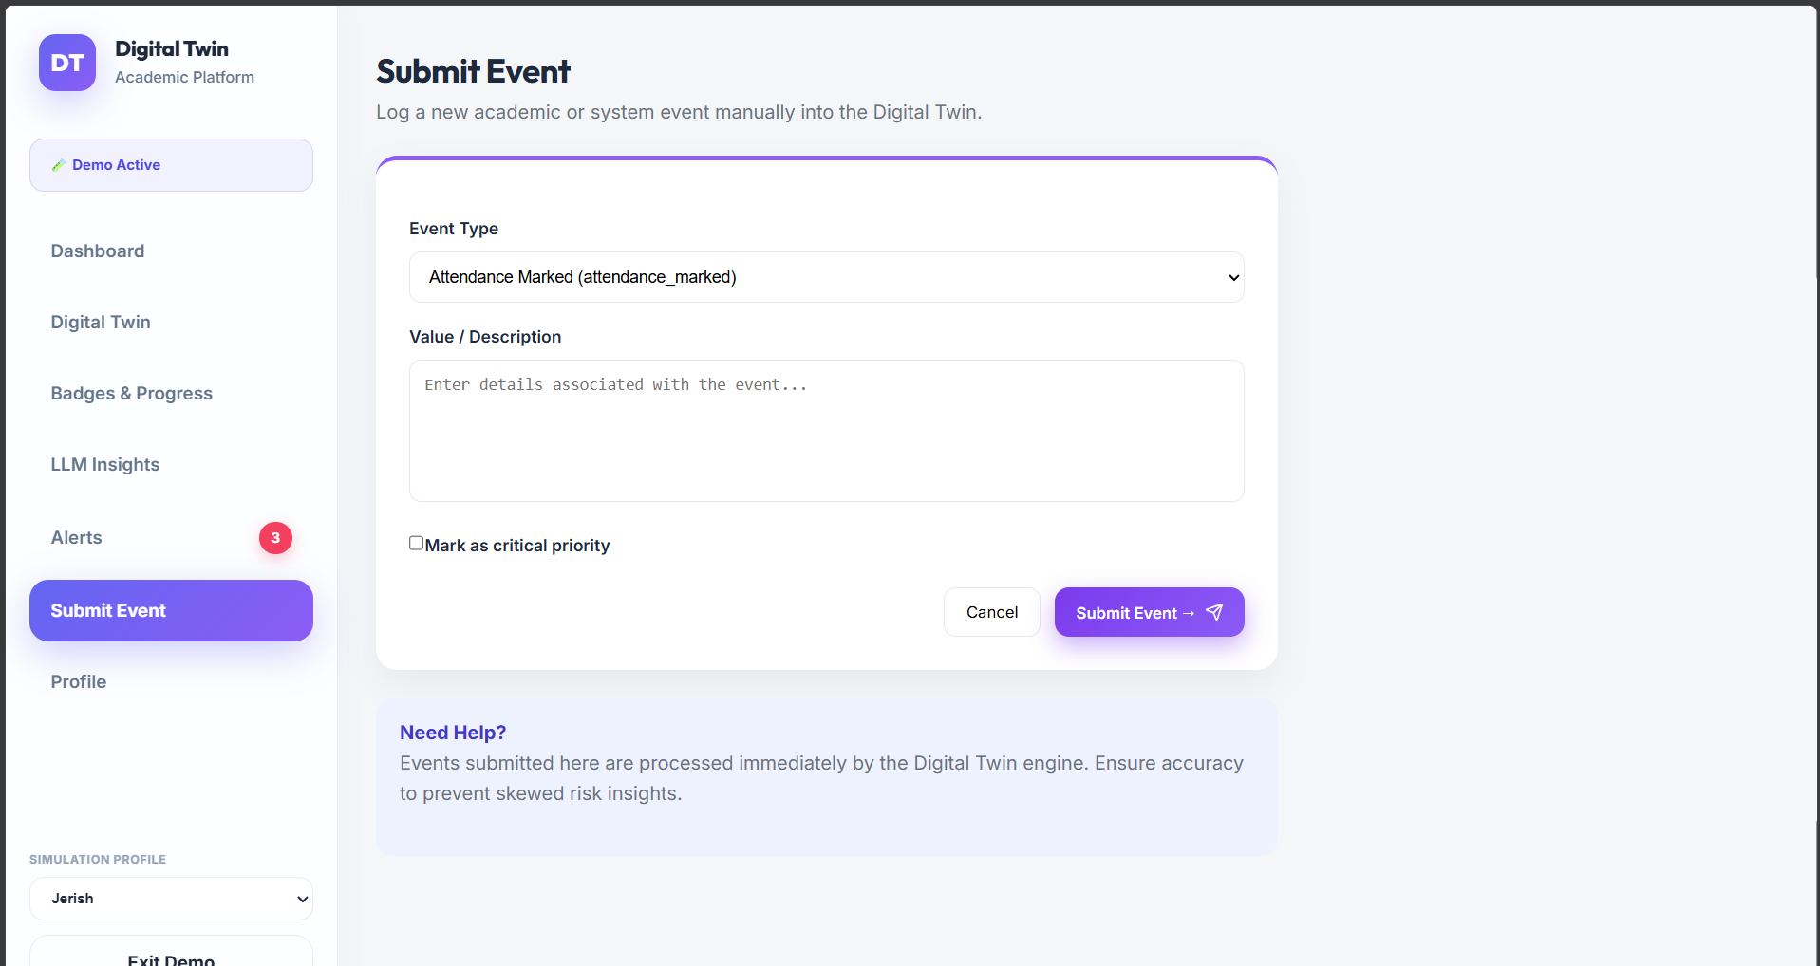
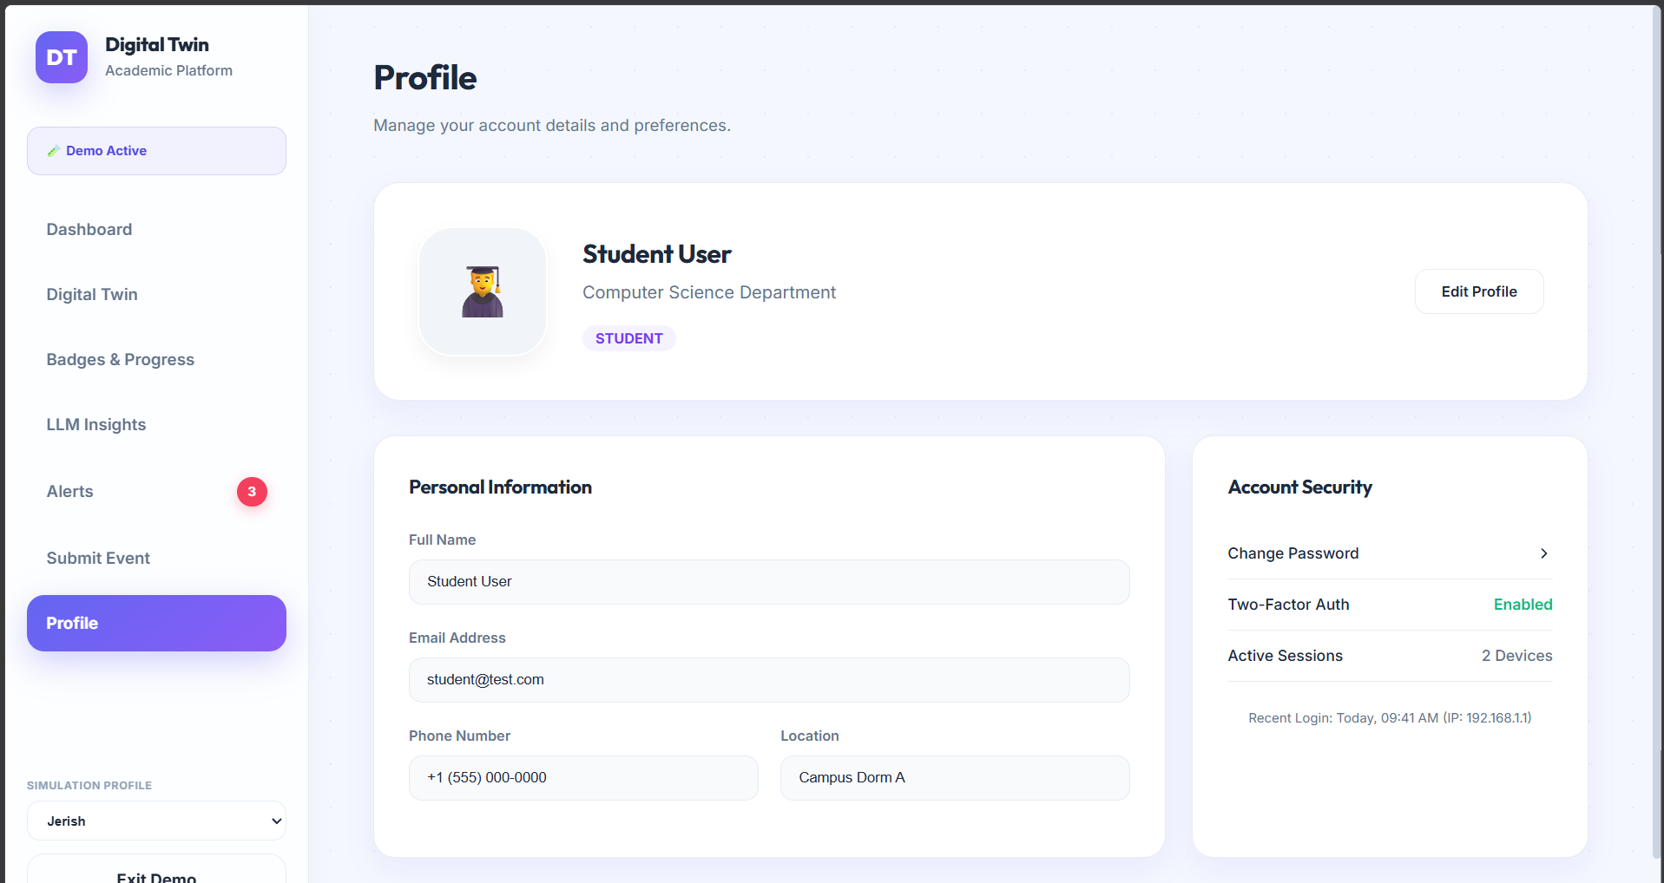
Implementation Module (Sample Output)
1. Student Dashboard
2. Digital Twin – semester progress
3. Badges & Progress
4. Alerts
5. Submit Event
6. Profile
Screenshots from the running prototype in demo / simulation mode.

Slide 8
Conclusion
Conclusion
Working end-to-end prototype: events → features → risk → Digital Twin → alerts → dashboards
Explainable risk scores with twin snapshots and trend history
JWT login with role-based access for student, teacher, parent and admin
Risk engine is currently rule-based
Future Work
Trained ML model for risk prediction
What-if simulator (shadow twin) for interventions
Closed-loop calibration against real outcomes
PostgreSQL database and deployment

Slide 9
References
Cagliero et al. (2021). Predicting Student Academic Performance by Means of Associative Classification.
Karalar et al. (2021). Predicting Students at Risk of Academic Failure Using Ensemble Model During Pandemic in a Distance Learning System.
Park & Yoo (2021). Early Dropout Prediction in Online Learning of University Using Machine Learning.
Dabhade et al. (2021). Educational Data Mining for Predicting Students’ Academic Performance Using Machine Learning Algorithms.
Tamada et al. (2022). Predicting Students at Risk of Dropout in Technical Course Using LMS Logs.
Yağcı (2022). Educational Data Mining: Prediction of Students’ Academic Performance Using Machine Learning Algorithms.
Oqaidi et al. (2022). Towards a Students’ Dropout Prediction Model in Higher Education Institutions Using Machine Learning Algorithms.
Segura et al. (2022). Machine Learning Prediction of University Student Dropout: Does Preference Play a Key Role?
Katsuragi & Tanaka (2022). Dropout Prediction by Interpretable Machine Learning Model Towards Preventing Student Dropout.
Su et al. (2022). Applying Machine Learning Technologies to Explore Students’ Learning Features and Performance Prediction.
Plak et al. (2022). Early Warning Systems for More Effective Student Counselling in Higher Education.
Qin et al. (2023). Early Warning of Student Performance With Integration of Subjective and Objective Elements.
Cho et al. (2023). A Study on Dropout Prediction for University Students Using Machine Learning.
Balcıoğlu & Artar (2023). Predicting Academic Performance of Students with Machine Learning.
Nagy & Molontay (2023). Interpretable Dropout Prediction: Towards XAI-Based Personalized Intervention.
Villar & Robledo Velini de Andrade (2024). Supervised Machine Learning Algorithms for Predicting Student Dropout and Academic Success: A Comparative Study.
Vaarma & Li (2024). Predicting Student Dropouts with Machine Learning: An Empirical Study in Finnish Higher Education.
Tiukhova et al. (2024). Explainable Learning Analytics: Assessing the Stability of Student Success Prediction Models by Means of Explainable AI.
Miranda et al. (2024). Machine Learning’s Model-Agnostic Interpretability on the Prediction of Students’ Academic Performance in Video-Conference-Assisted Online Learning.
Alalawi et al. (2024/2025). An Extended Learning Analytics Framework Integrating Machine Learning and Pedagogical Approaches for Student Performance Prediction and Intervention.

